Slide 1
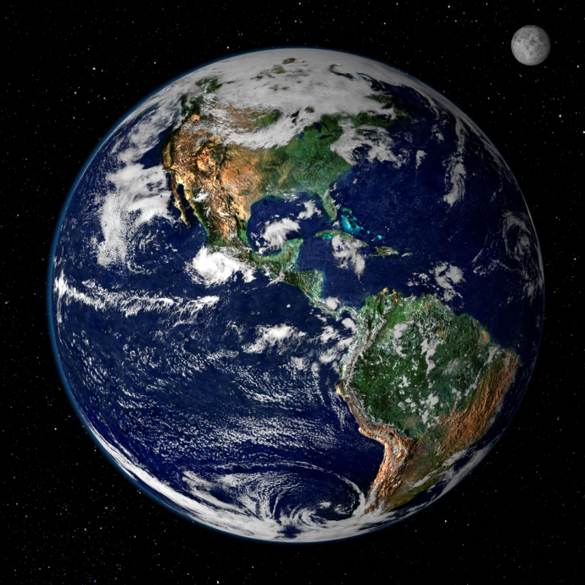


Global Climate Disruption:
How Do We Know?
What Can We Do?
Andy Jorgensen, Ph.D.
Associate Professor Emeritus of Chemistry, University of Toledo
School of Green Chemistry and Engineering
Senior Fellow, National Council for Science and the Environment
People for Peace and Justice Sandusky County

Slide 2
This talk provides accurate information about changes in climate, including the its impact on humans and other life forms.
Included are some ideas for how we can deal with these problems.
I hope that this information will help you discuss the problem with others, which I urge you to do.

Slide 3
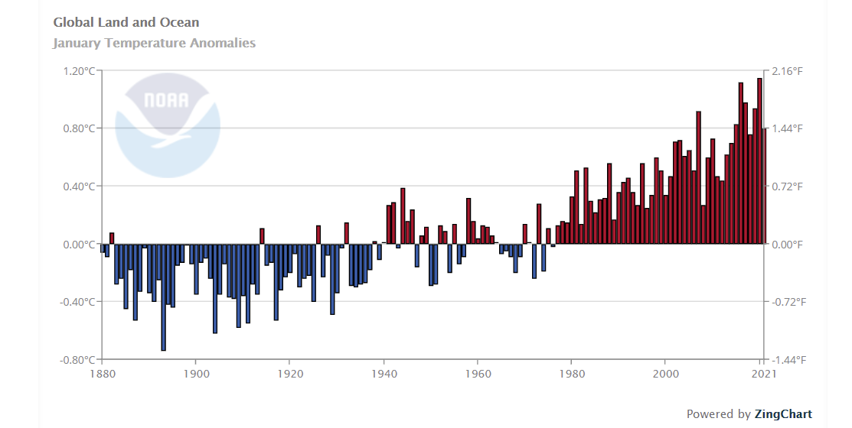
Global Temperature Measurements Through 2020
4 of the warmest years of modern times were since 2016. ➔
Link to source on most pages
NOAA National Centers for Environmental information, Climate at a Glance: Global Time Series, retrieved on February 15, 2021 fromhttps://www.ncdc.noaa.gov/cag/global/time-series

Slide 4

“The January 2020 global land and ocean surface temperature was the highest in the 141-year record at 2.05°F (1.14°C) above the 20th century average of 53.6°F (12.0°C)..”
The Earth has a fever!
https://www.ncei.noaa.gov/news/global-climate-202001

Slide 5
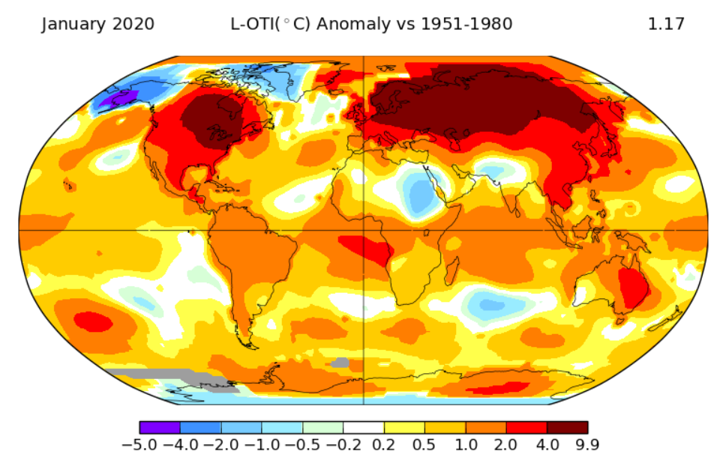
Note how uneven the increased temperatures are around the world.
Source: NASA GISS Surface Temperature Analysis:
http://data.giss.nasa.gov/gistemp/maps/

Slide 6
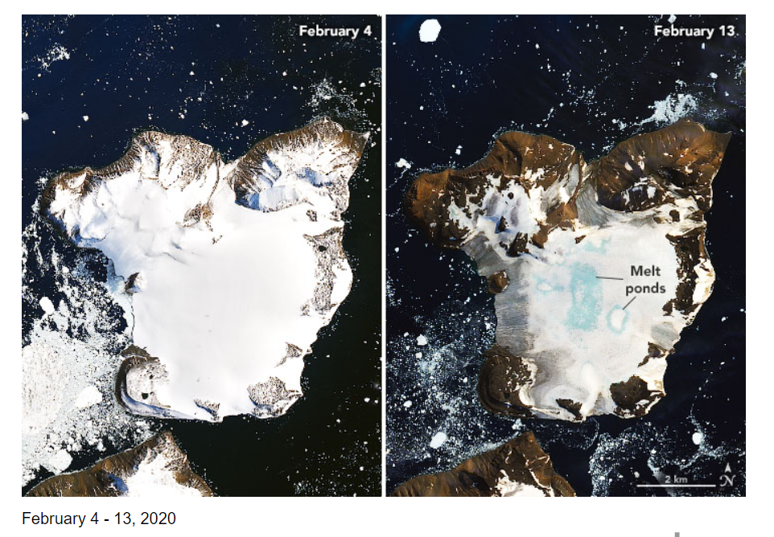
“On February 6, 2020, weather stations recorded the hottest temperature on record for Antarctica.”
Large amount of melting in just 9 days.
https://earthobservatory.nasa.gov/images/146322/antarctica-melts-under-its-hottest-days-on-record

Slide 7
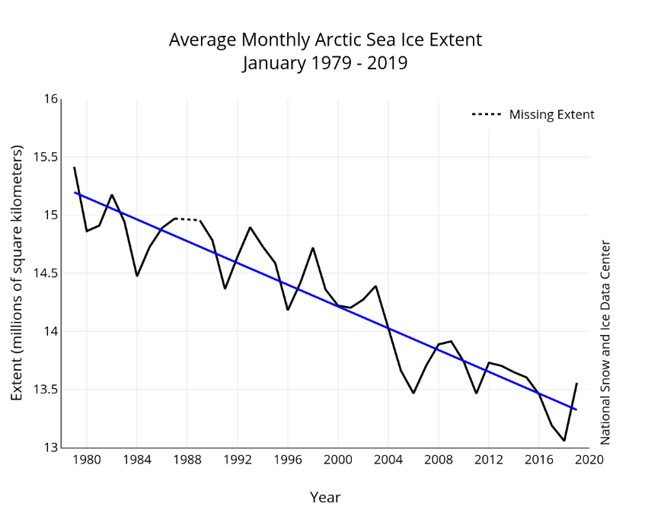
“The Arctic sea ice extent set a record low for July at 726,000 square miles (19.8%) below the 1981–2010 average…”
“The July 2019 Antarctic sea ice extent was 260,000 square miles (4.3%) below the 1981–2010 average and was the smallest July extent in the 41-year record.”
https://nsidc.org/arcticseaicenews/ and https://www.ncei.noaa.gov/news/global-climate-201907

Slide 8
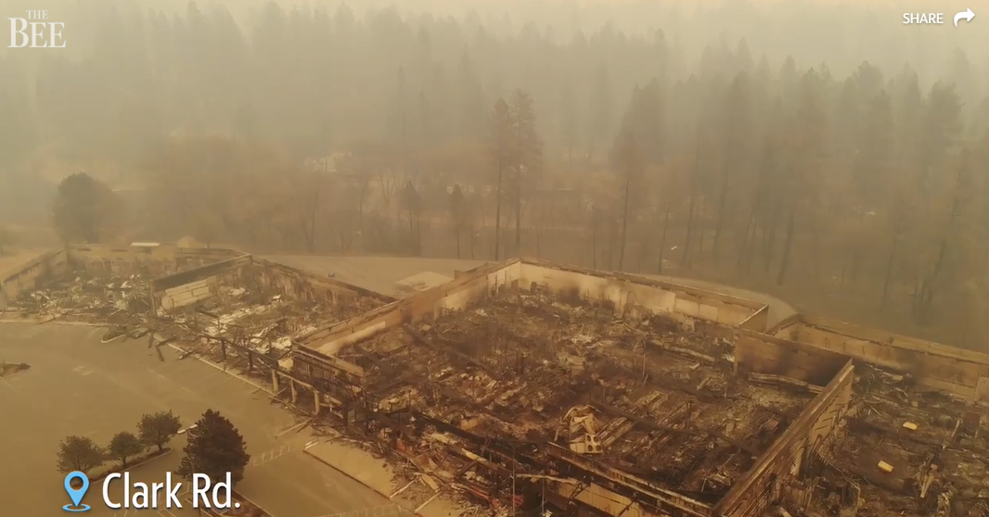
Wildfires in California – Paradise, 2018
85 lives lost
19,000 building destroyed
In Addition to Life and Property Losses
There are Broader Consequences
*California is the largest dairy state
*It grows 1/3rd of all US vegetables
*It grows 2/3rds of all US fruits & nuts
https://www.sacbee.com/news/california/fires/article230181114.html

Slide 9

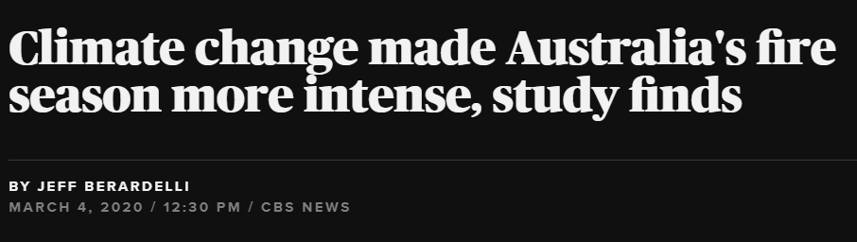
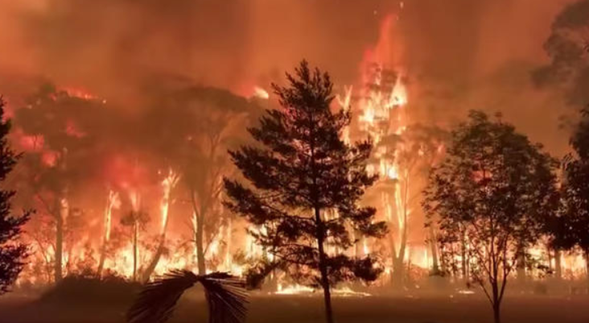
“By any measure, the 2019-2020 Australian bushfire season was catastrophic — burning 46 million acres, killing more than 1 billion animals and racking up an estimated price tag in the tens of billions of dollars….
“Now a new study released Wednesday by a group of leading scientists confirms those suspicions: Human-caused climate change did indeed make the fires in southeast Australia worse.”
https://www.cbsnews.com/news/climate-change-australia-fire-season-worse-study-finds/
Study: https://www.worldweatherattribution.org/

Slide 10
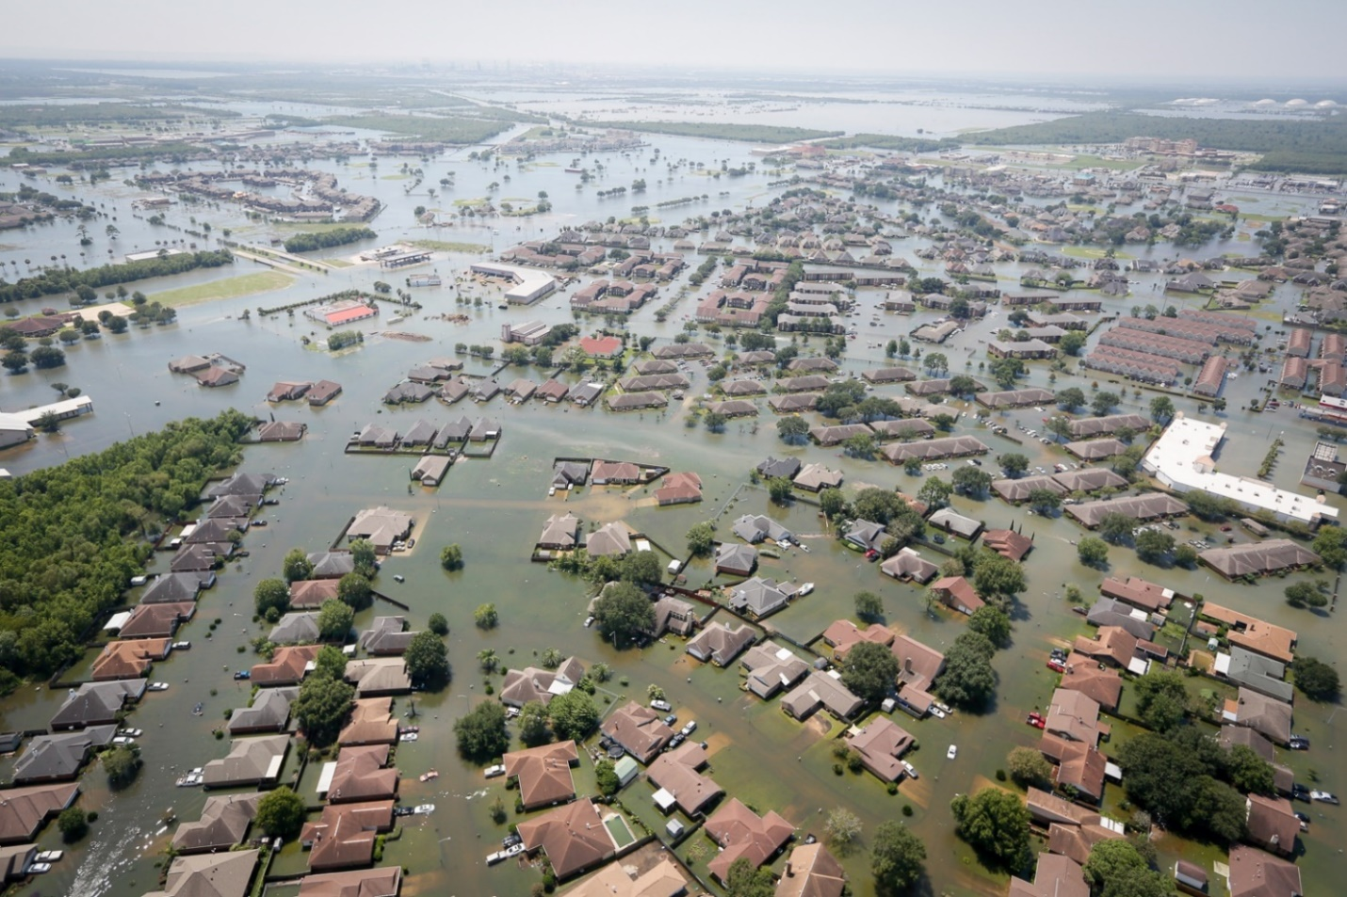
Hurricane Harvey in Texas Set Records in 2017:
”Harvey was the most significant tropical cyclone rainfall event in United States history, both in scope and peak rainfall amounts, since reliable rainfall records began around the 1880s. The highest storm total rainfall report from Harvey was 60.58 inches near Nederland, Texas...”
Port Arthur Texas 6 Days After Landfall
https://nca2018.globalchange.gov/chapter/1/ and https://www.nhc.noaa.gov/data/tcr/AL092017_Harvey.pdf

Slide 11
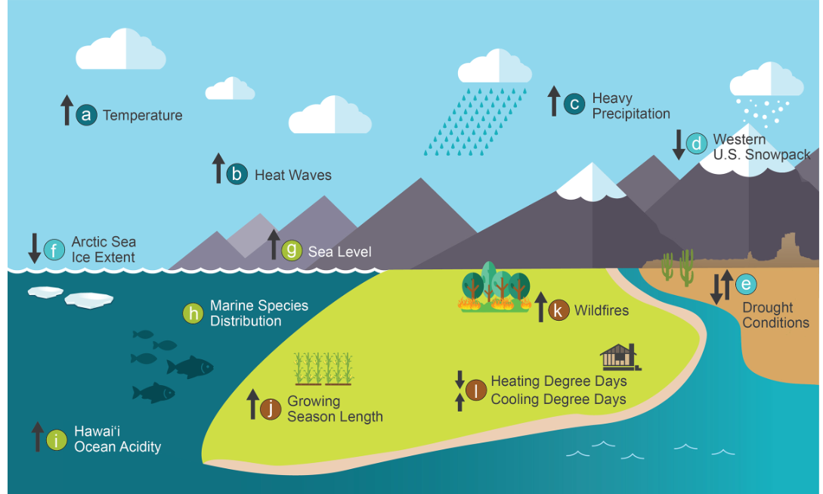
12 Indicators of Recent Climate Change
https://nca2018.globalchange.gov/chapter/1/

Slide 12
Why is Earth’s temperature changing?

Slide 13
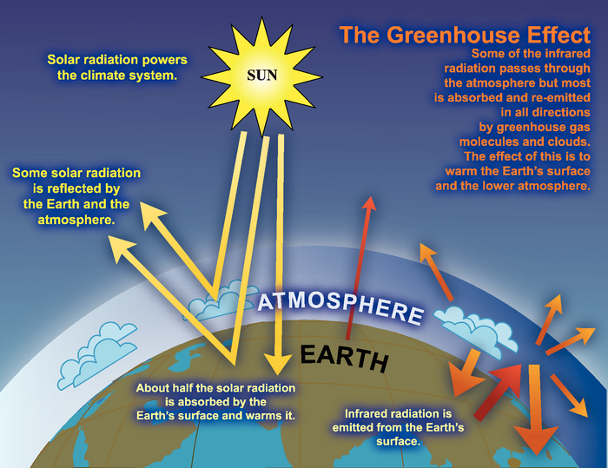
https://www.ipcc.ch/publications_and_data/ar4/wg1/en/faq-1-3.html

Slide 14
The primary chemical causing an enhanced Greenhouse Effect is carbon dioxide in the atmosphere.

Slide 15
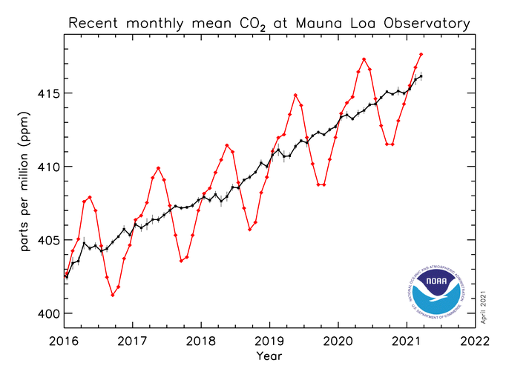

Its concentration was less than 300 ppm for centuries.
As of 2021 it has increased to over 415 ppm.
http://www.esrl.noaa.gov/gmd/ccgg/trends/index.html

Slide 16
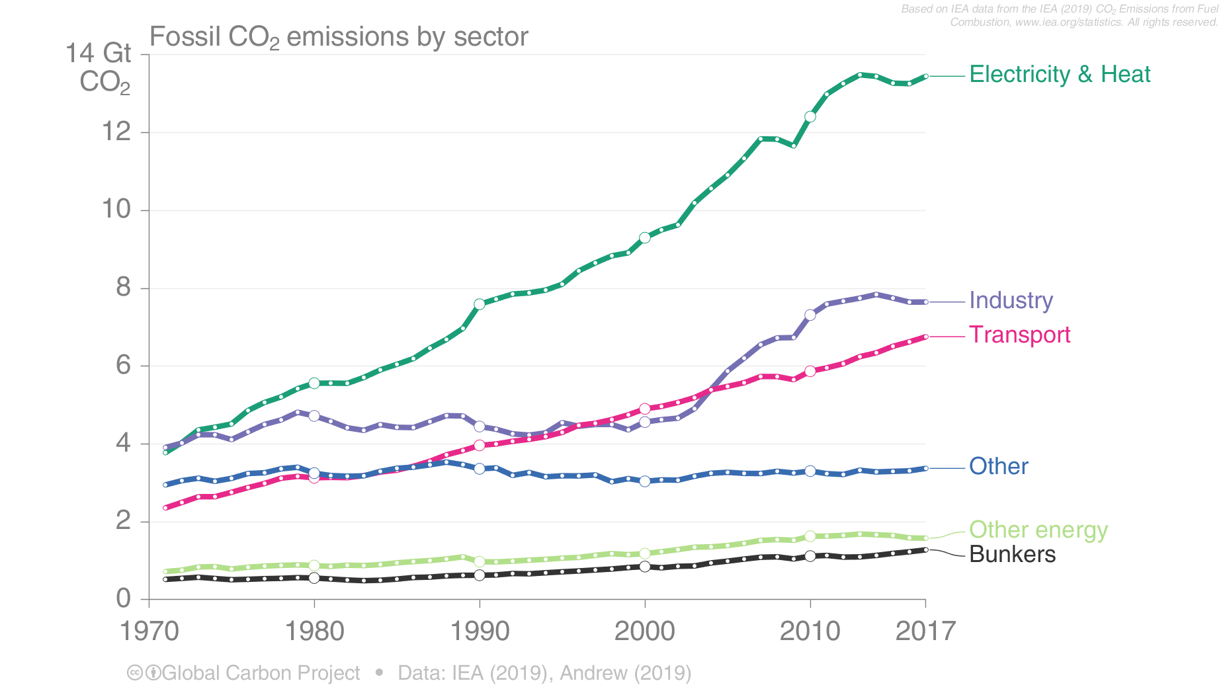
Emissions of Fossil CO₂ Emissions by Sector
Global fossil CO₂ emissions are dominated by electricity, heat, & energy (45%), industry (23%), & national transport (19%).
International aviation and marine bunkers are 3.5% & remaining sectors 10%.
45%
Source: IEA 2019; Peters et al 2019; Global Carbon Budget 2019

Slide 17
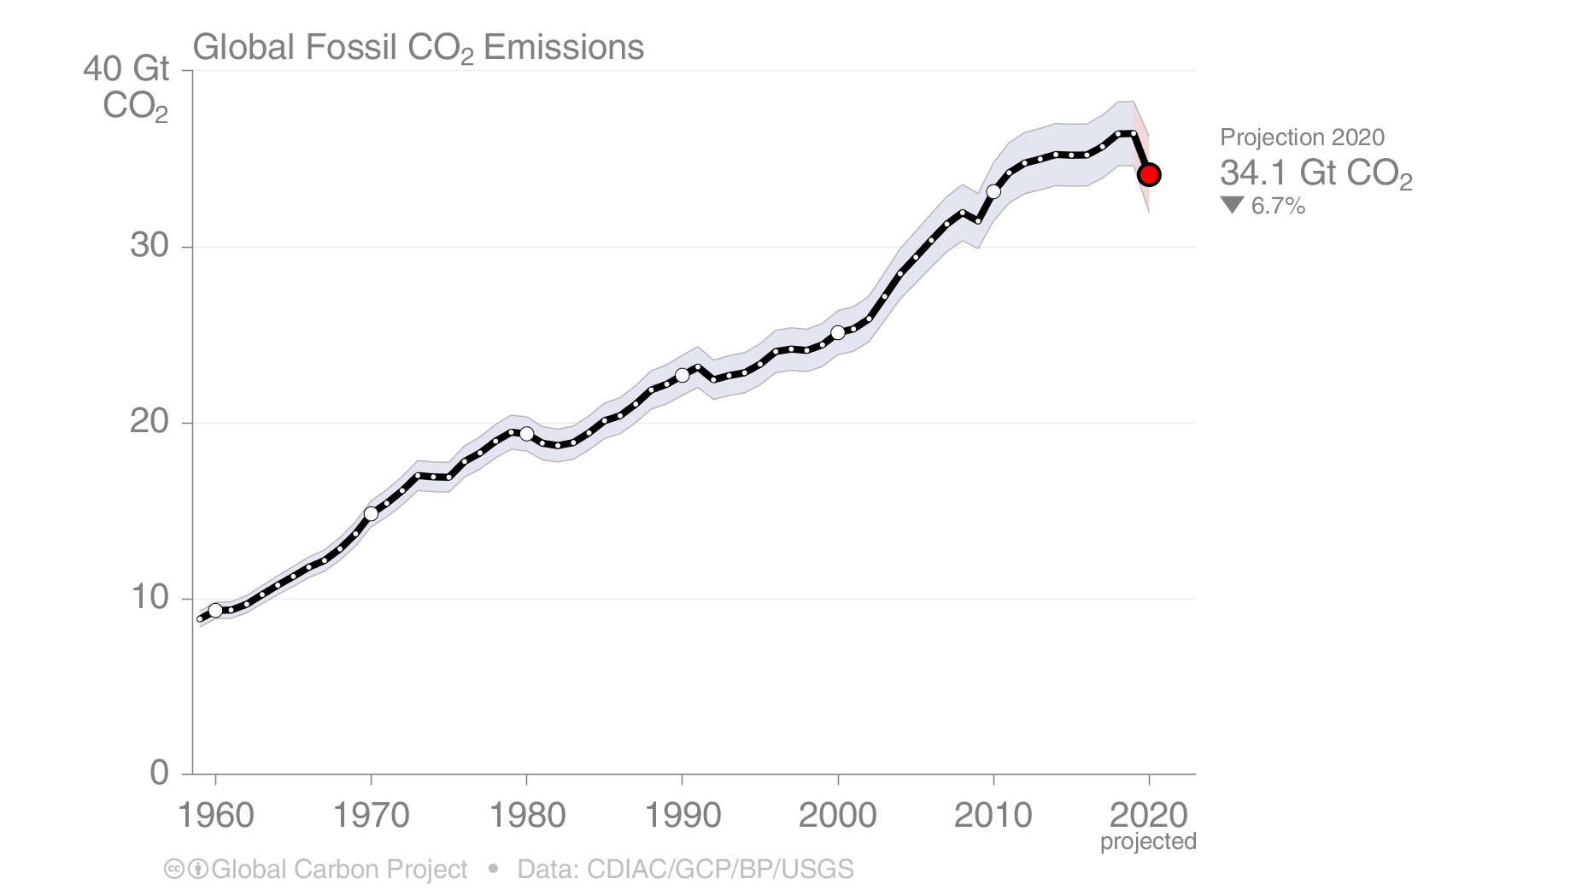
Global Fossil CO₂ Emissions
Global fossil CO₂ emissions have risen steadily over the last decades
While 2020 has witnessed an unprecedented drop, emissions will likely rebound in 2021
Modest decrease of 6.7% due to reductions related to COVID, but it is not a sustainable effect.
The 2020 projection is based on preliminary data and modelling.
Source: CDIAC; Friedlingstein et al 2020; Global Carbon Budget 2020

Slide 18
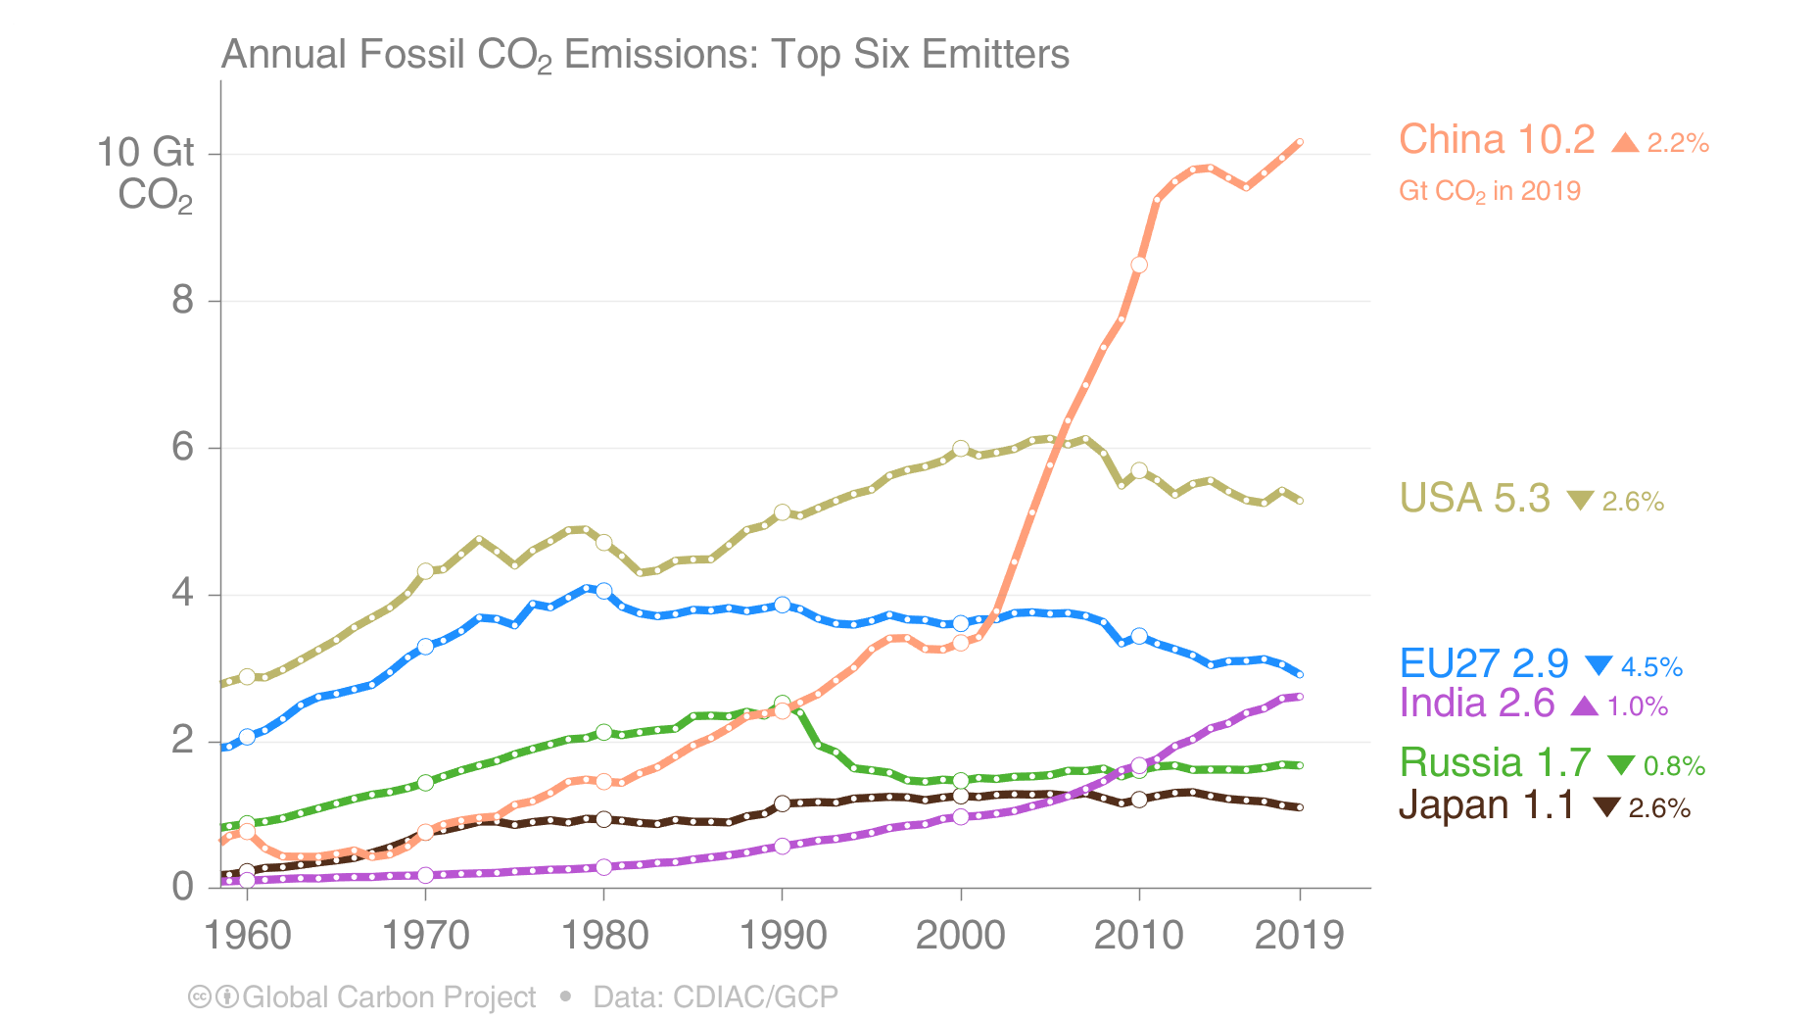
Top emitters: Fossil CO₂ Emissions to 2019
China is the largest, but they have 4 times the US population.
The top six emitters in 2019 covered 65% of global emissions
China 28%, United States 15%, EU27 8%, India 7%, Russia 5%, and Japan 3%
Bunker fuels, used for international transport, are 3.5% of global emissions.
Source: CDIAC; Peters et al 2019; Friedlingstein et al 2020; Global Carbon Budget 2020

Slide 19
16.1
Source: CDIAC; Friedlingstein et al 2020; Global Carbon Budget 2020

Slide 20
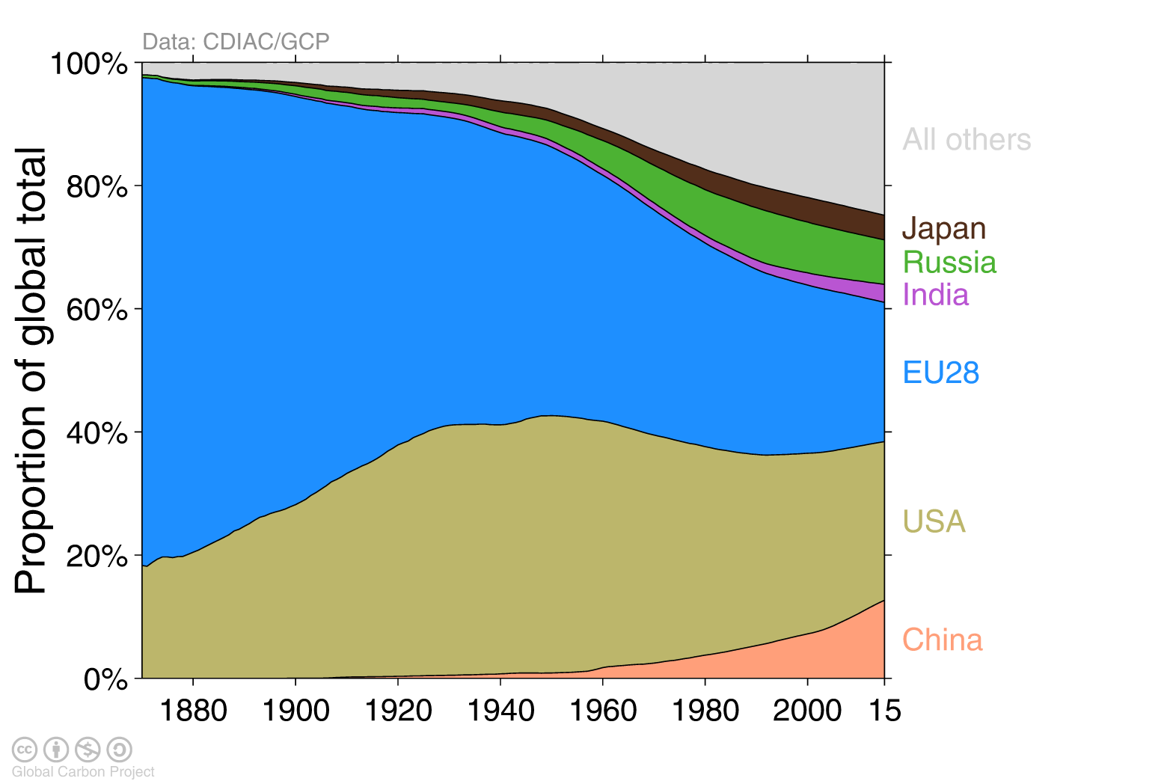
Historical cumulative emissions by country
Cumulative emissions from fossil-fuel and cement were distributed (1870–2015):
USA (26%), EU28 (23%), China (13%), Russia (7%), Japan (4%) and India (3%)
November, 2016
Cumulative emissions (1990–2015): China (21%), USA (20%), EU28 (14%), Russia (6%), India/Japan (4%)
‘All others’ includes all other countries along with bunker fuels and statistical differences
Source: CDIAC; Le Quéré et al 2016; Global Carbon Budget 2016

Slide 21

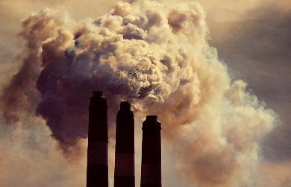

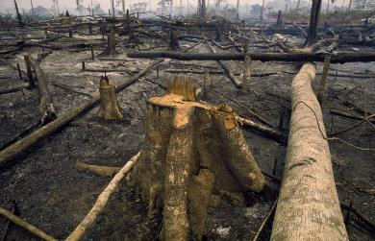
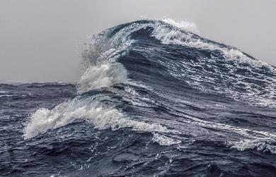
Fate of anthropogenic CO₂ emissions (2010–2019)
Almost half remains in the atmosphere for many years.
Sources = Sinks
18.6 GtCO₂/yr
46%
34.4 GtCO₂/yr
86%
31%
12.5 GtCO₂/yr
14%
5.7 GtCO₂/yr
23%
9.2 GtCO₂/yr
Budget Imbalance:
(the difference between estimated sources & sinks)
0.4%
0.2 GtCO₂/yr
Source: Friedlingstein et al 2020; Global Carbon Budget 2020

Slide 22
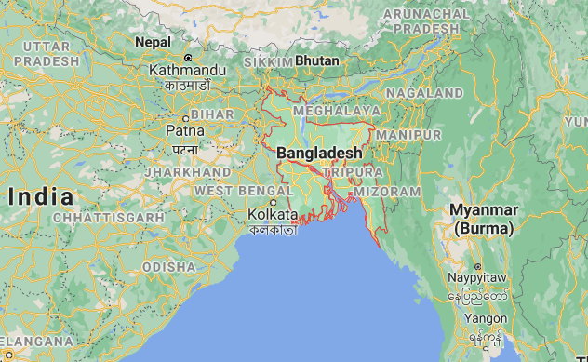
Ethical Impact of Climate Change
Bangladesh: 161 million people
Google Map
“As of 22 July, 2020, 102 upazila and 654 unions have been inundated in flood, affecting 3.3 million people and leaving 7,31,958 people water logged. 93 people has already lost their life,…”
Their emissions are less than 0.5 tons per person.
https://reliefweb.int/report/bangladesh/bangladesh-monsoon-floods-2020-coordinated-preliminary-impact-and-needs-assessment

Slide 23
So what? It has been warmer before, so why should we be concerned?
The population of the world was not 7.3 billion
  With perhaps 100 million living near sea coasts
Agriculture & animal cycles have developed with the climate before recent changes
The present change is very rapid

Slide 24
Facts About Climate Change
In Past 100+ Years
The average temperature of the earth has increased, with 2016 highest directly measured. 2020 about tied.
  January 2020 warmest January
CO₂ concentrations have increased by >40%
Sea level has increased, though modestly (<1 ft)
  But the rate of increase is 3x historical rate

Slide 25
Mitigation Strategies
Term refers to reducing the problem.
Reducing CO₂ and other GHG Emissions by
  Improved efficiency: homes, cars, manufacturing
  Changing to alternate fuels or nuclear fuel
  Reducing destruction of plants and trees
  Personal actions….

Slide 26
We will look at the Carbon Footprint of a typical American family and how it can be reduced.
If you are one person in a family of 4 in the US
Average house with natural gas heat & electric AC
You drive 1,200 miles per month in a small car
Eating a “heavy” amount of meat.
No airplane flights

Slide 27

This website will allow you to calculate the amount of carbon dioxide produced to live as assumed – and the decrease in carbon dioxide with various changes.
You can check it out yourselves for your family!
https://www.carbonfootprint.com/calculator.aspx

Slide 28
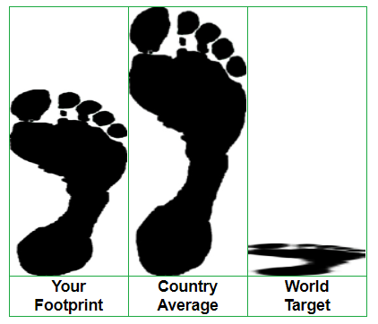
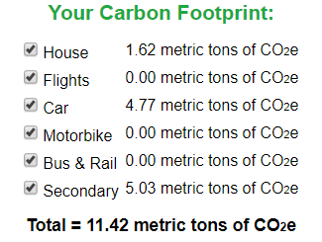
Typical Footprint for Concerned Person
For the original set of values:
11.42 16.1 2

Slide 29
Which change would cause the greatest reduction of emissions?
Drive 10% less 1,010 pounds
Reduced food consumption by 10% 530 pounds
Reduce meat consumption from heavy to medium 1,140 pounds

Slide 30
How much would you save from the original plan if you made these changes:
Cut electricity, natural gas, miles by 10% and meat consumption to low
1,990 pounds
2,780 pounds
3,635 pounds
4,185 pounds

Slide 31
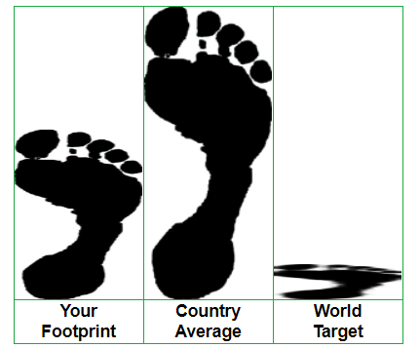
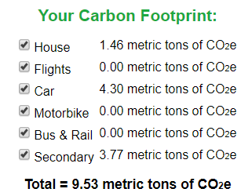
Footprint for Very Prudent Person
For all 10% reductions given above and low meat:
9.53 16.1 2
A reduction of 1.89 tons or 4,158 pounds!
The Europe average is 6.4 tons

Slide 32
Footprint for Very Prudent Person
For all 10% reductions given above and low meat:
9.53 16.1 2
A reduction of 1.89 tons or 4,158 pounds!
The Europe average is 6.4 tons
A RT flight Detroit-Orlando emits about 1.77 tons!

Slide 33
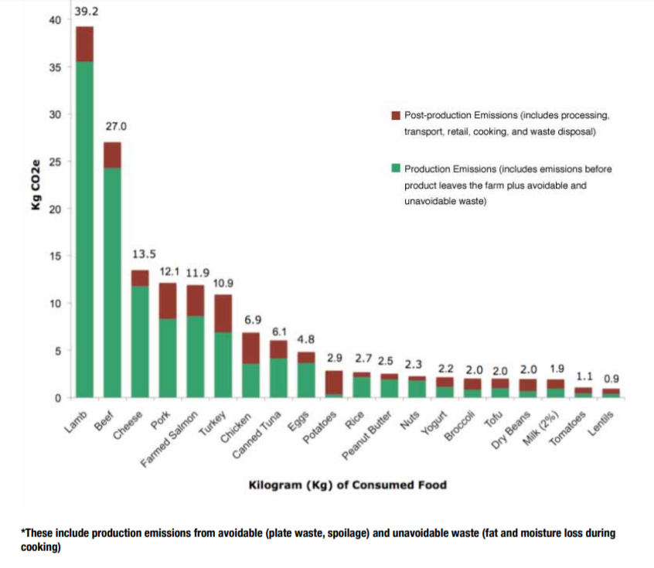
Producing many foods causes the release of large amounts of carbon dioxide.
http://static.ewg.org/reports/2011/meateaters/pdf/methodology_ewg_meat_eaters_guide_to_health_and_climate_2011.pdf

Slide 34


Change your …..
Using electric blankets allows you to reduce heat to your whole house while keeping you comfortable.

Slide 35
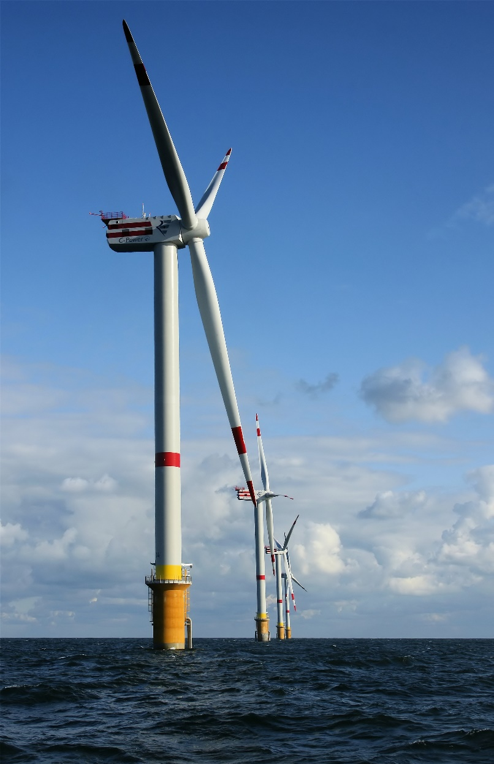
Use Renewable Energy - Wind
By © Hans Hillewaert, CC BY-SA 4.0, https://commons.wikimedia.org/w/index.php?curid=6361901

Slide 36
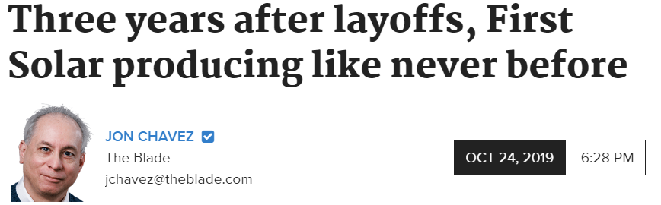



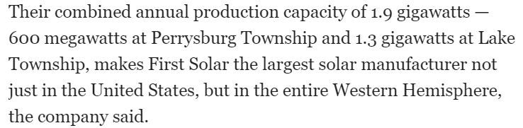
https://www.toledoblade.com/business/energy/2019/10/24/first-solar-energy-producing-like-never-before-perrysburg-lake-township-business/stories/20191024186

Slide 37
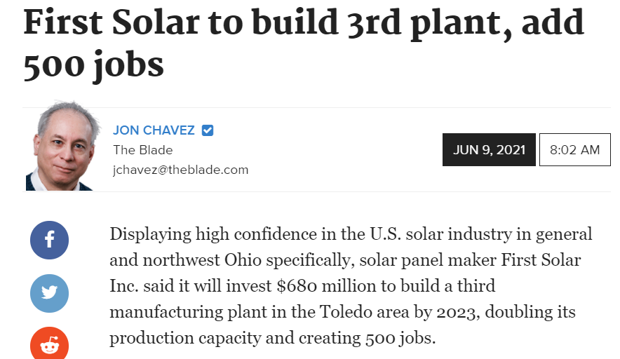

Slide 38

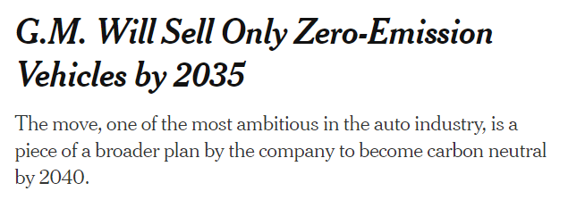
By Neal E. Boudette
Jan. 28, 2021Updated 2:40 p.m. ET
The days of the internal combustion engine are numbered.
General Motors said Thursday it would phase out petroleum-powered cars and trucks and sell only vehicles that have zero tailpipe emissions by 2035, a seismic shift by one of the world’s largest automakers that makes billions of dollars today from gas-guzzling pickup trucks and sport-utility vehicles.
G.M. stock jumped after its announcement and was up more than 4 percent around 2 p.m., reflecting a growing consensus among investors that electric cars represent the future and that Tesla and other electric carmakers will eventually dominate the auto industry, while businesses that do not make the transition to electrics will do poorly.
https://www.nytimes.com/2021/01/28/business/gm-zero-emission-vehicles.html?action=click&module=Top%20Stories&pgtype=Homepage

Slide 39
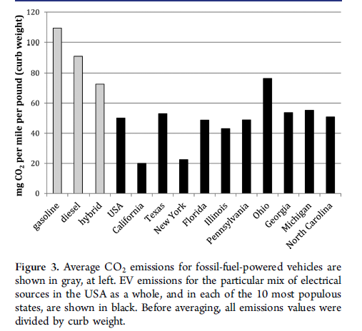
Compare Emissions of Electric Vehicles to
Gas and Diesel Vehicles.
"A Comparison of Carbon Dioxide Emissions from Electric Vehicles to Emissions from Internal Combustion Vehicles" Dan Berger, Andy Jorgensen, Journal of Chemical Education, DOI 10.1021/acs.jchemed.5b00125, July, 2015

Slide 40

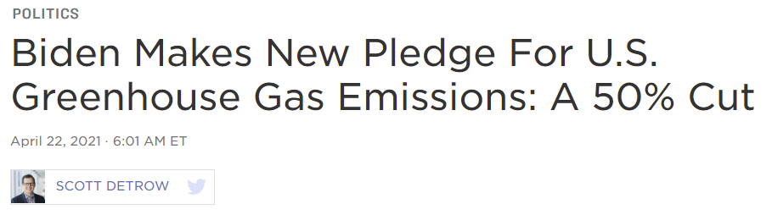
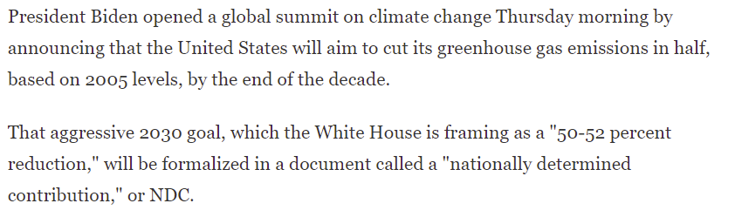
In the News Early in 2021:
From another source: Through 2020 the drop has been about 25%, but some of that was due to the temporary COVID effect.
https://www.npr.org/2021/04/22/989491975/at-climate-summit-biden-stresses-u-s-commitment-and-economic-opportunity

Slide 41
Best Possible First Step….
Don’t Waste!!!!

Slide 42
Opinions on Climate Change After Hearing the Facts
743 increase
+16.7%
108 Presentations: N=5,248 N=5,082

Slide 43
Are You Willing to Reduce Your Emissions?
About 75% committed to make a change in their lives – so over 4,000 people.
N=5,500

Slide 44

What Else Can You Do?
Tell your friends and family members!
The next generations need us to respond.

Slide 45

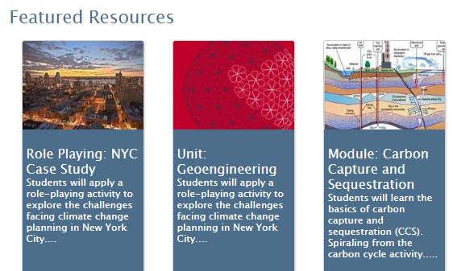
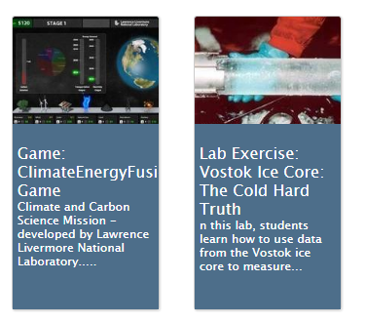
Web Resource on Climate Change
*http://camelclimatechange.org/index.html

Slide 46


Acknowledgments
NASA for support under Global Climate Change Education
Award# NNX09AL64G
“Creation and Dissemination of an Interdisciplinary Undergraduate General Education Course on Climate Change”
National Science Foundation for support under Climate Change Education
Award #DUE-0950396
"Creating a Learning Community for Solutions to Climate Change"
Acknowledge David Kitchen & Scott Mandia for information
Matthew Jorgensen and Tom Kina for technical assistance.

Slide 47
You are welcome to invite me to speak to your group online or in person.
Andy Jorgensen andy.jorgensen@utoledo.edu

